Slide 1
ESOL Conversation Program
Volunteers

Slide 2
Welcome & Introduction
My name is Cameron Busacca
MA - International Education Policy
Taught Conversational English in France - High school Students
I love “Culture” - any way it’s defined
I love soccer
I hope to open an international school for orphans someday

Slide 3
Welcome
My name is Agbor Beteck
Junior Economics Major
Previous Experience with ESOL Program
Bilingual- French & English
Maryland Images Campus Tour Guide
Enjoy traveling

Slide 4
What is the ESOL Conversation Program
The UMD ESOL (English for Speakers of Other Languages) Conversation Program is a student centered community that specifically aims to bring students and community members from diverse cultures together through authentic language learning/teaching, cultural exchange, social activities, and a passion for minorities.
Why do you participate?

Slide 5
How This Process Works
1.We find volunteers - you!
2.You set your bio and schedule.
3.We allow students to choose sessions with volunteers.
4.Students and volunteers meet!
5.If Volunteers don’t have students, and students don’t have volunteers, we will work together to find a solution.

Slide 6
Session Types
One-on-one Conversation Partners - (60 min)
Small Conversation Groups - 2 students (90 min)
Big Conversation Groups - up to 8 students (90 min)
Three different levels -> Beginner, Intermediate, Advanced
Levels of Proficiency

Slide 7
Determine Hours & Set Schedule -> SetMore
Volunteer Bio - Who are you?
What types of sessions do you want?
What level of difficulty?
You schedule your time.
Now let’s see the new scheduling software, SetMore.
Volunteer Bio, Setmore, Parking Pass

Slide 8
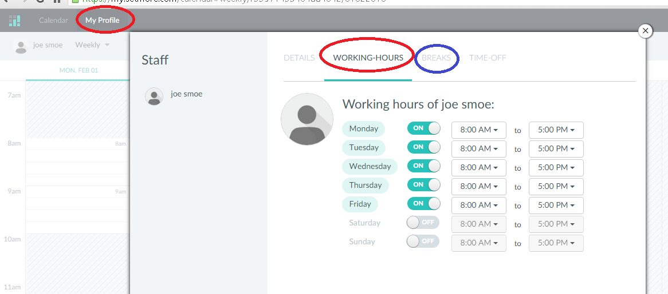

Slide 9
Parking Passes!
Parking passes are available to Volunteers!
You must fill-in the form completely!
Wait until you set your schedule. If you have no sessions before 4pm, then you do NOT need to fill out a parking pass form.
*Car: Parking is free after 4:00 p.m. in numbered lots (lots 1-19)
*Note: numbered lots have white background and black letters (Lot 1 is recommended)
I will contact each of you once the parking pass has been given.

Slide 10
Guidelines
Sessions must occur on campus.
Volunteers can accept gifts from students less than $15.
If you need to be absent, please e-mail/contact your students at least 24 hours before each session.
Student Attendance Issues -> Email umdesol@gmail.com if it becomes an issue

Slide 11
Suggestions, Tips and Strategies(for Conversation Groups):
When reading, please try not to use round robin (going around the circle/group in reading the content). Students might get intimidated.
Have each student do a show-and-tell (present sth that they are passionate about) and have other students ask questions as they learn about it.
KEY: If other students can talk/contribute, let them talk and contribute.
What one student wants may not be what other students would like to talk about. Send out surveys or simply ask students to reach consensus. You can also have students rank the topic(s) that they are most interested in.



Slide 12
1. How can you make sure that everyone in the group/your conversation partner gets to speaks thoughtfully on topics discussed without taking too much time?
Use Think-pair-share if needed so that each student gets to talk to their “elbow” partners and have them report back the most interesting answers (so there won’t be many duplicates).
2. What do you do/say to motivate the student(s) to participate more? How often do you do it? What are some ways of conveying that message to your student(s) without repeating it?
Action speaks louder than words. Be an attentive listener and probe (ask them to elaborate) students’ responses when necessary.
3. A student says, “All we do is talk about ideas/opinions in the class, they wouldn’t miss me if I were to miss out today.” How can we make the discussions more interactive and more meaningful to students?
Make sure every student gets to talk about the topic (engage them).
Connect your sessions from previous/upcoming weeks.
Example: week 2 (personalities); week 3 (interpersonal relationships and values); week 4 (family and societal values) (Moving more globally).

Slide 13
Roles of Volunteers (all valid roles)
Approaches depend on the topic, age of the language learners, previous work done and other factors.
1. Committed – volunteer is free to propagate own views. Care needs to be taken with this role, however, as this can lead to a biased discussion.
2. Objective or Academic – volunteer transmits an explanation of all possible viewpoints without stating own position.
3. Devil’s Advocate – volunteer adopts provocative and oppositional stances irrespective of own viewpoint.
This enables the volunteer to ensure that all views are covered and challenged if a consensus view emerges early on. It also helps to challenge language learners’ existing beliefs.


Slide 14
Roles continued
4. Advocate – volunteer presents all available viewpoints then concludes by stating own position with reasons.
The volunteer can then make the point that it is important for participants to evaluate all viewpoints before forming their own opinions.
5. Impartial Chairperson – volunteer ensures that all viewpoints are represented, through language learners statements or published sources. Volunteer facilitates but refrains from stating own position.
6. Declared Interest – volunteer declares own viewpoint so that language learners can judge later bias, then presents all available positions as objectively as possible.
Resource: Oxfam GB 2006.


Slide 15
Last Tips
Try to have a visual representation of the questions for the students (paper, on the board, sent through e-mail ahead of time etc.) –students can refer back to it.
Large Groups: think-pair-share
Write down your agenda on the board or have a “bucket list”
“Funds of Passion”- talk about something you are passionate about.
Use the Resources page! We will post lesson plans and helpful discussion topics!

Slide 16
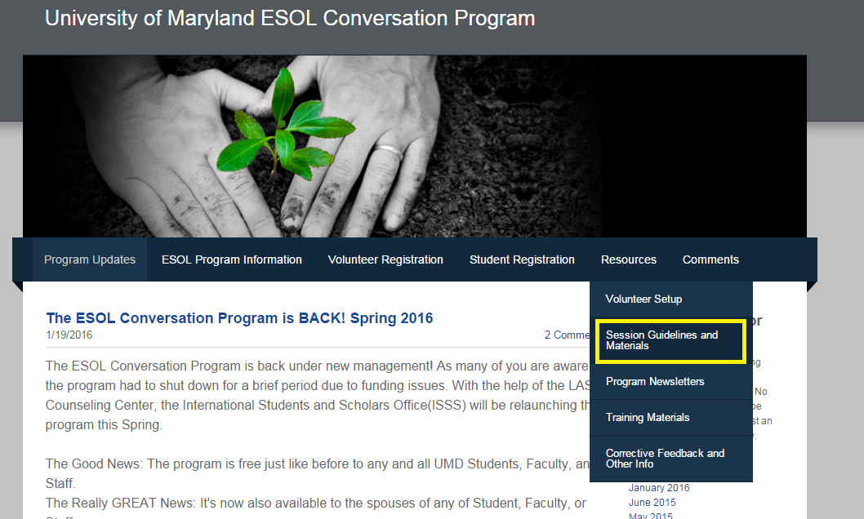
Resources

Slide 17
Questions?
Now’s the time to ask!

